Slide 1
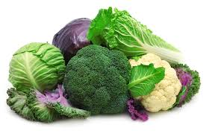
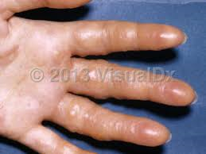
Isothiocyanate glycosides (glucosinolates)
A group of glycosides which upon hydrolysis by the enzyme myrosinase yield a glucose and aglycon which undergo spontaneous rearrangement with the loss of sulphate to give an isothiocyanate as the major product. In this type of glycoside the sulphur atom is bonded to sugar (S-glycoside) and the second sulfur present in sulfonated oxime group.

Slide 2
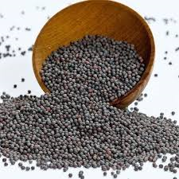
Examples:
Black Mustard
Botanical Name: Brassica nigra
Family: Family: Brassicaceae
Part used: Dried seeds

Slide 3
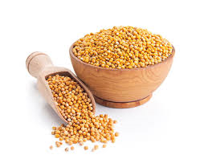
Uses :
Stimulant -A drug that temporarily quickens some vital process
Emetic -A medicine that induces nausea and vomiting
Diuretic –Increase urination

Slide 4
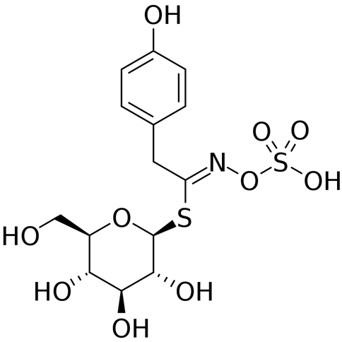

Slide 5
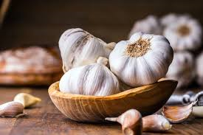
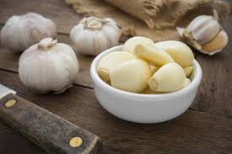
Also white mustard contain myrosinase enzyme which hydrolyzed Sinalbin.

Slide 6
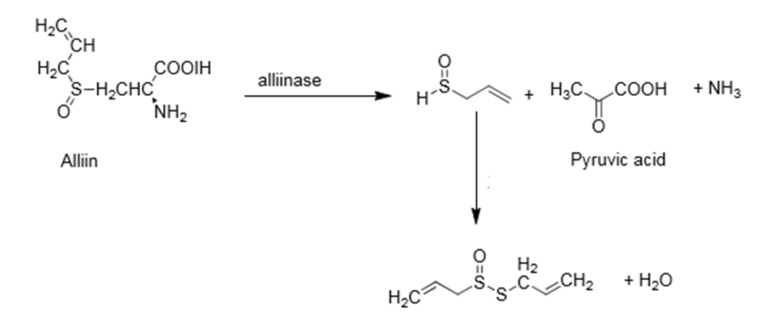

Slide 7
